Slide 1
Securing ATM Transactions with Facial Recognition-Based Verification Systems

Slide 2
Abstract
ATM or Automated Teller Machines are widely used by people nowadays. Performing cash withdrawal transaction with ATM is increasing day by day. The existing conventional ATM is vulnerable to crimes because of the rapid technology development.
A secure and efficient ATM is needed to increase the overall experience, usability, and convenience of the transaction at the ATM. Specifically, the goal of this project is to give a computer vision method to solve the security risk associated with accessing ATM machines.
This project proposes an automatic teller machine security model that uses electronic facial recognition using Deep Convolutional Neural Network. Face Verification Clickbait Link will be generated and sent to bank account holder to verify the identity of unauthorized user through some dedicated artificial intelligent agents, for remote certification.

Slide 3
Existing System
Existing ATM authentication method is the use of password-PINs and OTP.
QR cash withdrawals were enabled so customers could ditch their ATM cards and simply scan a QR-code on ATMs using the QR app to withdraw cash.
ATM security system architecture that incorporates both the finger print and GSM technology into the existing PIN-based authentication process.

Slide 4
Disadvantages
Eavesdropping, Shoulder surfing, Spoofing, Brute-force attack can preform in the existing system.
Skimming and Trapping of the ATM devices have been designed by many Burglars.
Scanning the magnetic strip in the ATM cards will give the complete details of the card. This causes the duplication of the cards.
Since the PIN is static it is easy for criminals to extract it from the users, through hacking or even through brute force applied to the person.

Slide 5
Proposed System
This project proposes an automatic teller machine security model that would combine a physical access card and electronic facial recognition using Deep Convolutional Neural Network.
Face Detection and Recognition: This module captures the image of the user's face and applies Convolutional Neural Network (CNN) algorithms to detect and recognize the user's face.
Face Verification Link Generation: Once the user's identity is confirmed, this module generates a face verification link and sends it to the authorized account holder's mobile number. The link contains the face image of the user captured at the time of transaction and is used for verification purposes.

Slide 6
Proposed System
3. Mobile based Unauthorized Verification
This module is responsible for receiving the face verification link on the authorized account holder's mobile number and verifying the link to confirm the user's identity. The link is accessible only for a limited time, and the system sends an alert to the user if the link is not accessed within the specified time.

Slide 7
Advantages
The advantages can be found as that the face-id is unique for everybody; it cannot be used by anybody other than the user.
It can be used to reduce fraudulent attempts.
To prevent theft and other criminal activities.
Secure facial authentication platform that users can trust
Provide safe and secure lifestyle infrastructure
Prevent unauthorized access using Face verification Link.
Fast and Accurate Prediction

Slide 8
System Specifications
Operating System: Windows 10 or higher
Back End: Python
Database: MySQL
Python Packages: Numpy, Pandas, Matplotlib, and Scikit-learn
Web Server: Apache Web Server (in WampServer)

Slide 9

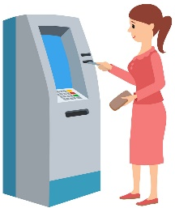

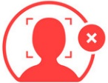
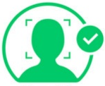


System Architecture
Bank Server
Dispatch to Account Holder
Captured Face
Generate ATM ID
Enrol Account Holder Face
Account Creation
Face Verification
Login
AH
Transaction
Bank
Unknown Face Forwarder Link
Account Holder
Bank Security Protocol

Slide 10
Module 1. ATM Simulator
The ATM Simulator is designed t roeplicate the functionalities of a physical Automated Teller Machine. The User Authentication Module ensures secure access by validating user credentials and verifying Personal Identification Numbers (PINs).
The Account Overview Module provides users with a snapshot of their accounts, displaying balances and recent transactions.
Additional modules include Change PIN for security updates, Transaction History for a detailed record of activities, and Card Management for actions like blocking or unblocking cards.
The Alerts and Notifications Module keeps users informed of account activities, while the Settings Module enables customization of preferences.Together, these modules create a comprehensive and realistic ATM simulation experience for users and developers alike.

Slide 11
Module 2. End User Interface
2.1. ATM System
Cardholder Interaction
Upon inserting their ATM card into the interface, users kick-start transactions. The system promptly reads the card details to facilitate seamless transaction processing.
Facial Recognition
Simultaneously, the system employs advanced facial recognition technology to capture the user's face. This captured image is then meticulously compared with the pre-trained face model stored in the system's database.
Security Measures
In scenarios where a facial match is identified, the transaction proceeds effortlessly. However, in cases of non-matching faces, the system activates additional security measures to safeguard the transaction.

Slide 12
Module 2. End User Interface
Face Verification Link
For added security, the system generates a Face Verification Link. This link is promptly dispatched to the mobile number linked to the card account, ensuring an extra layer of identity confirmation.
User Approval Process
The cardholder, upon receiving the Face Verification Link, is prompted to verify their identity. Once approval is granted, the ATM dispenses the requested amount; if not, the system securely retrieves the card to prevent unauthorized access.

Slide 13
Module 2. End User Interface
2.2. ATM User/Account Holder Interaction
Cash Withdrawal
When an ATM user seeks to withdraw cash, they simply insert their card, initiating a streamlined process. The system then verifies the user through multi-factor authentication.
2.3. Bank Employee Interaction
Secure Login
Bank employees gain access to the system through a secure login process, ensuring that only authorized personnel can manage the ATM functionalities.
Account Management
Equipped with secure access, bank employees can seamlessly create new bank accounts, streamlining the on boarding process for customers.

Slide 14
Module 2. End User Interface
Facial Recognition Training
As a security enhancement, the system allows bank employees to record a live video for approximately 30 seconds to train the account holder's face. This data contributes to the continuous enhancement of the facial recognition model, fortifying overall security.
Generate ATM ID, Dispatch to Account Holder
Upon the creation of a new account, the system generates a unique ATM ID. This ID is dispatched to the account holder, completing the account creation process.

Slide 15
Module 3. Face Recognition
3.1. Dataset Creation: Account Holder Face by Recording Live Video for 30secs
The process begins with actively creating a comprehensive dataset by recording a live video of the account holder's face for approximately 30 seconds.
Frame Conversion
Post dataset acquisition, the system seamlessly converts video frames into individual images. This step is pivotal for simplifying subsequent image processing and analysis. It enables the system to work with discrete frames, facilitating more efficient handling and manipulation during pre-processing.

Slide 16
Module 3. Face Recognition
3.2. Pre-processing
This pre-processing module encompasses multiple steps to optimize images for subsequent analysis.
Grey Scale Conversion: The conversion to greyscale simplifies image representation, reducing complexity.
Noise Filter: The application of mean or Gabor filtering minimizes noise, enhancing the clarity of facial features.
Binarize: Converting images to binary format further streamlines feature extraction. These steps collectively contribute to creating a standardized and enhanced image dataset.

Slide 17
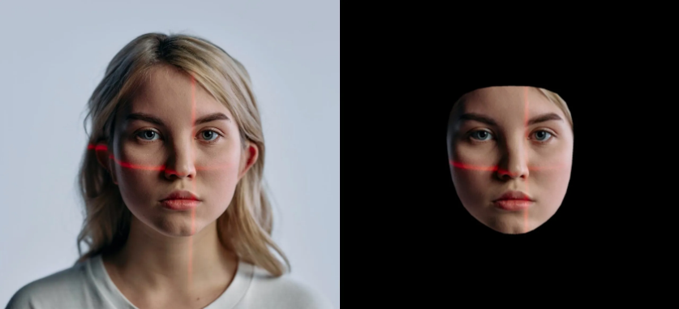
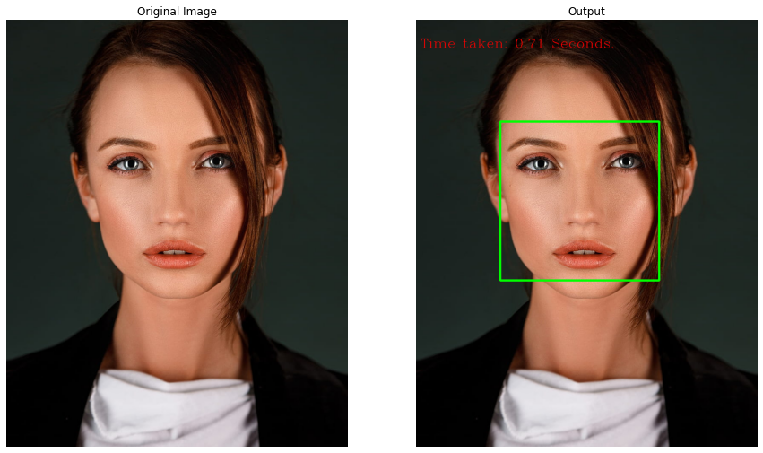
Module 3. Face Recognition
3.3. Face Detection
Leveraging a Region Proposal Network (RPN), this module identifies potential face regions within the pre-processed images. RPN excels at proposing regions likely to contain facial features, laying the groundwork for subsequent processing. It streamlines the computational effort by focusing on regions of interest, enhancing efficiency in face recognition.

Slide 18
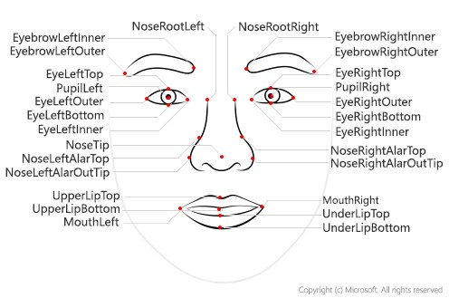
Module 3. Face Recognition
3.4. Face Feature Extraction
This module focuses on extracting relevant features from the detected face regions using Gray Level Co-occurrence Matrix (GLCM). GLCM captures statistical information about pixel intensity relationships, offering a rich set of features for subsequent classification. It serves as a robust method for characterizing facial textures and patterns.

Slide 19
Module 3. Face Recognition
3.5. Classification using CNN (Convolutional Neural Network)
Employing a Convolutional Neural Network (CNN), this module classifies the extracted face features. The CNN is trained on the dataset, learning intricate patterns and representations crucial for accurate face recognition. The hierarchical structure of a CNN enables it to automatically learn discriminative features from the input images.

Slide 20
Module 3. Face Recognition
3.6. Build and Train Model
This module involves the construction of the face recognition model using the pre-processed dataset and the training of the model on the extracted features. The model is iteratively optimized using machine learning techniques to ensure accurate face recognition across diverse conditions.
3.7. Deploy the Model in ATM Server
Upon successful training, the face recognition model is seamlessly integrated and deployed within the ATM server. This integration allows real-time face recognition during transactions, contributing to enhanced security and user authentication.

Slide 21
Module 4. Face Identification
4.1. ATM Captures User's Face
The Face Identification module commences with the ATM employing integrated cameras or sensors to capture a live image of the user's face during a transaction. This process is crucial for obtaining a real-time representation of the user's facial features, capturing nuances such as facial expressions, contours, and unique identifiers.
4.2. Extract Features
Following the capture of the facial image, the system moves to the extraction phase where it identifies and isolates key features from the user's face. These features include but are not limited to facial landmarks, texture patterns, and distinctive attributes that collectively contribute to a comprehensive and unique facial profile.

Slide 22
Module 4. Face Identification
4.3. Identify Users with Trained Model
The crux of the Face Identification module lies in the identification process, where the extracted facial features are compared with a pre-trained face identification model.
It has learned to recognize and differentiate specific individuals based on their unique facial characteristics.
Prediction Process: In real-time identification, the extracted features are compared with the patterns stored in the pre-trained model.
Authorization Decision: The identification process ultimately influences an authorization decision, determining whether the user is authorized to proceed with the requested transaction.

Slide 23
Module 5. Face Verification Link Generator
5.1. Generate Face Verification Link
In response to non-matching faces, the system promptly generates a Face Verification Link. This link is designed to serve as a secure and temporary reference for the user's facial profile, introducing an extra layer of security for subsequent verification steps.
5.2. Link Transmission to User's Mobile Number
The Face Verification Link is swiftly transmitted to the user's mobile number, enhancing security by sending the link to the device associated with the authorized account holder. This proactive step ensures that the user is promptly informed and involved in the verification process.

Slide 24
Module 6. Face Verification Process
Upon receiving the Face Verification Link, the authorized account holder engages in a secure and user-friendly process to validate the user at the ATM. The following steps outline the Face Verification Process:
6.1. Link Access and View User
The authorized account holder receives the Face Verification Link on their mobile device. By clicking the link, they are directed to a secure page displaying the captured image of the user at the ATM.
6.2. User Approval
After viewing the user's image, the authorized account holder has the option to approve the user's identity. This approval step is crucial for authorizing the subsequent transaction and confirming that the individual at the ATM is indeed the legitimate account holder.

Slide 25
Module 6. Face Verification Process
6.3. Enter Amount and PIN
Upon approving the user, the account holder proceeds to enter the desired withdrawal amount and their unique Personal Identification Number (PIN). This step confirms their intention to proceed with the transaction.
6.4. Confirmation and Money Dispensation
With the entered amount and PIN, the account holder confirms the transaction. The ATM machine, recognizing the approved user, dispenses the requested amount of money.
6.5. Unknown User Handling
In the event that the user at the ATM is unrecognized or deemed unauthorized, the account holder has the option to take immediate action. This may include blocking the user directly through the link interface, enhancing security measures against potential fraudulent activities.

Slide 26
Module 7. Notification
The Notification Module is triggered by various events within the system. These events could include successful transactions, security alerts, account activity updates, or any other significant occurrences requiring user attention.
The module supports different types of notifications, such as in-app alerts, SMS messages, or email notifications. Users are notified in real-time about successful or unsuccessful transactions.
Transaction alerts include details such as transaction amount, date, time, and the location of the transaction. These alerts may include unauthorized access attempts, unusual spending patterns, or any activity that deviates from normal user behaviour.
Users are kept informed about changes to their account, such as balance updates, account statements, or any modifications to personal information.

Slide 27
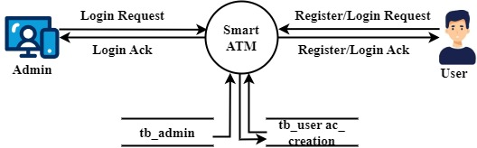
Data Flow Diagram
LEVEL 0

Slide 28
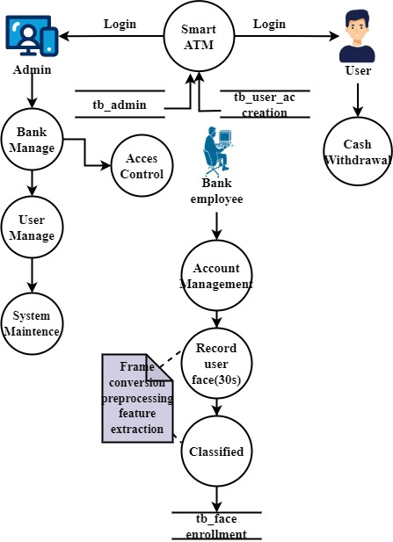
Data Flow Diagram
LEVEL 1

Slide 29
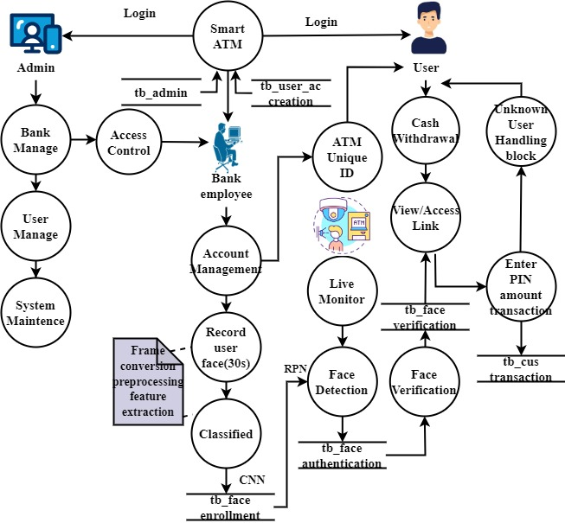
Data Flow Diagram
LEVEL 2

Slide 30
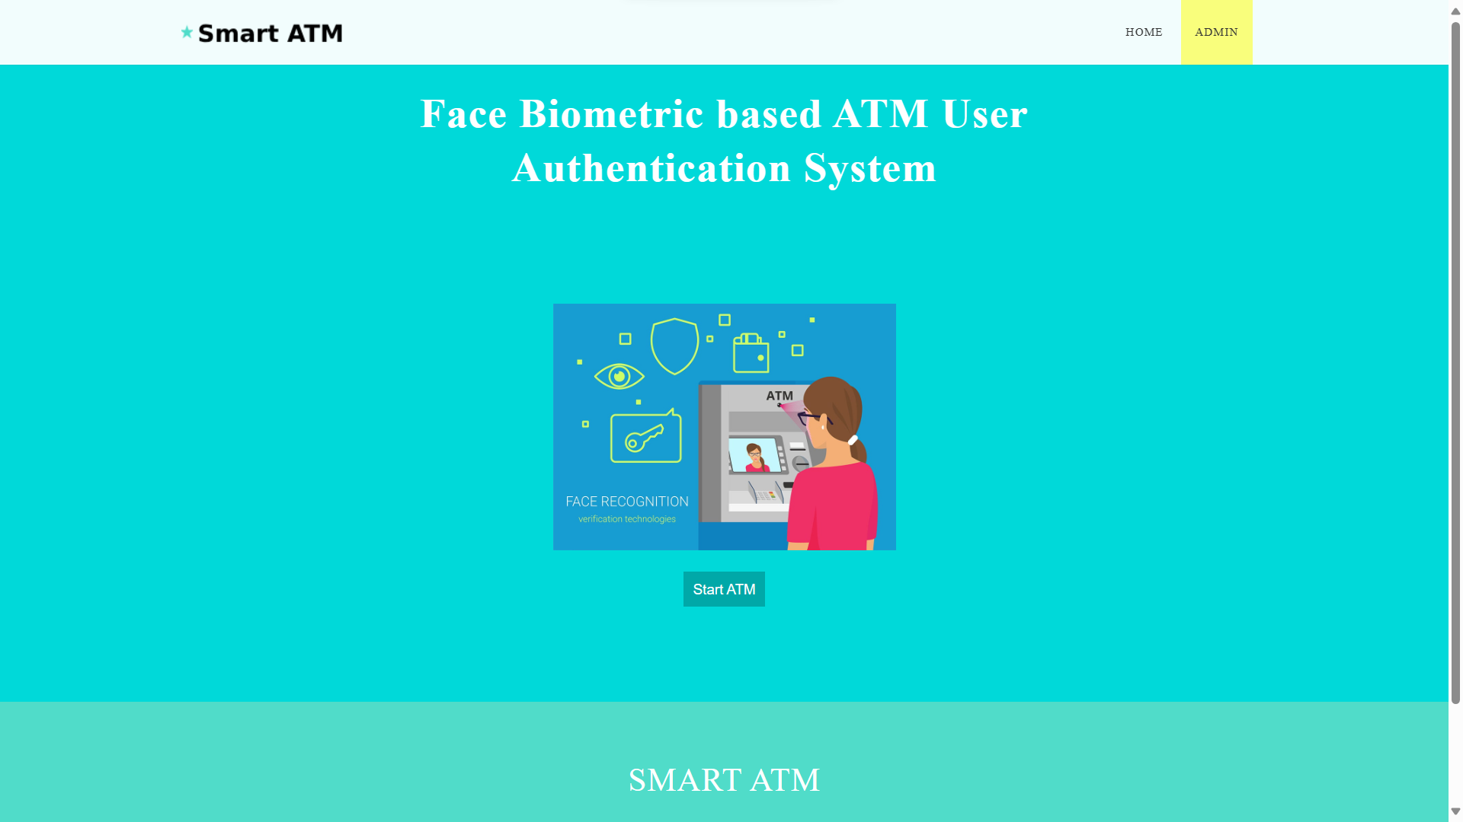
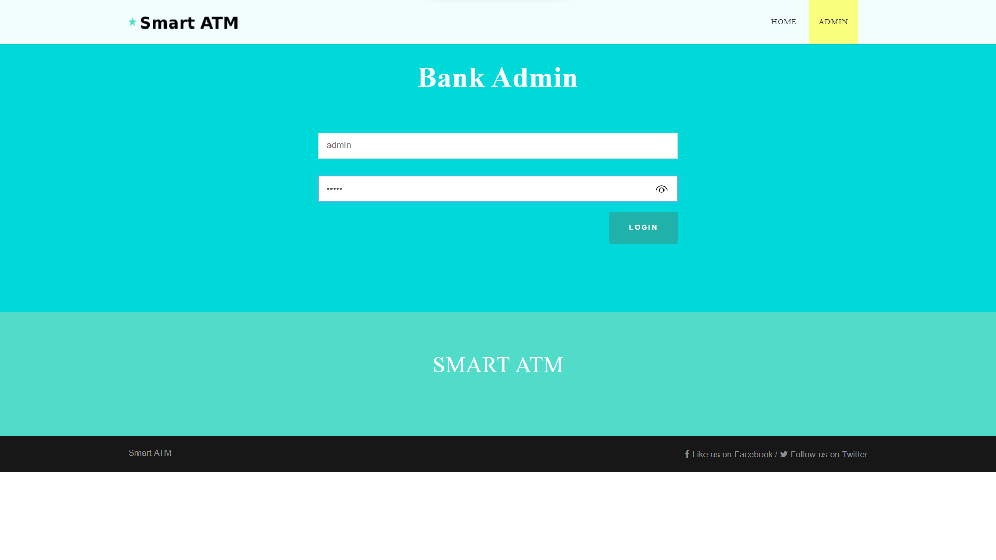
Screen Shots

Slide 31
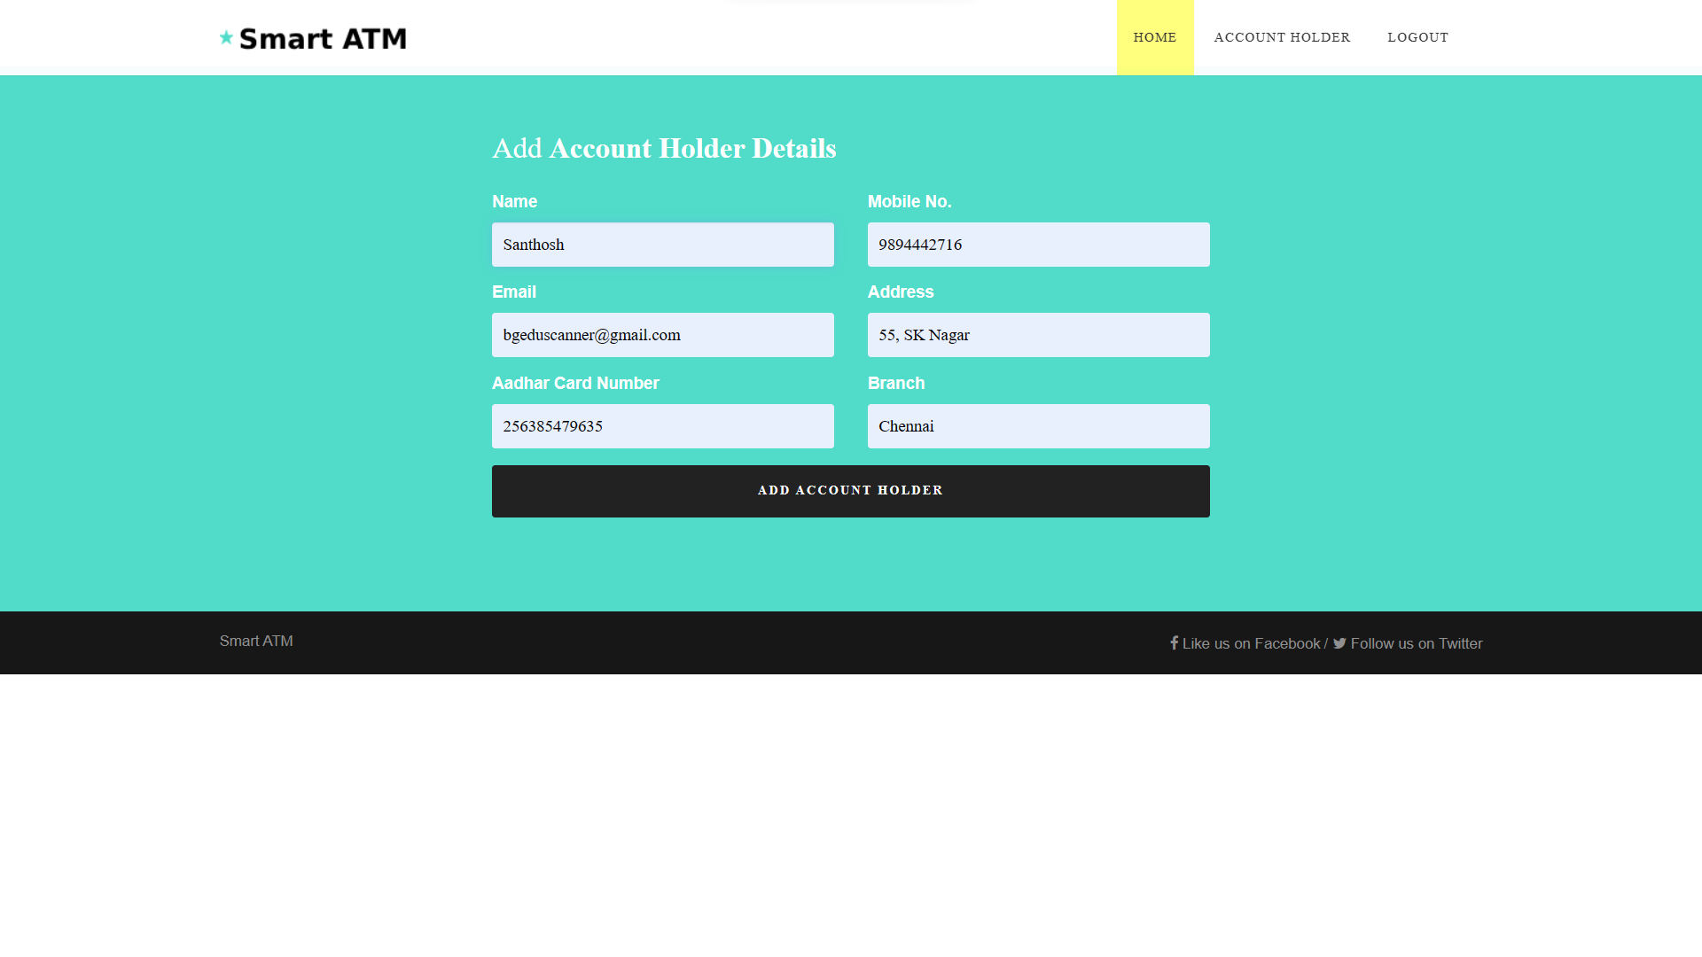
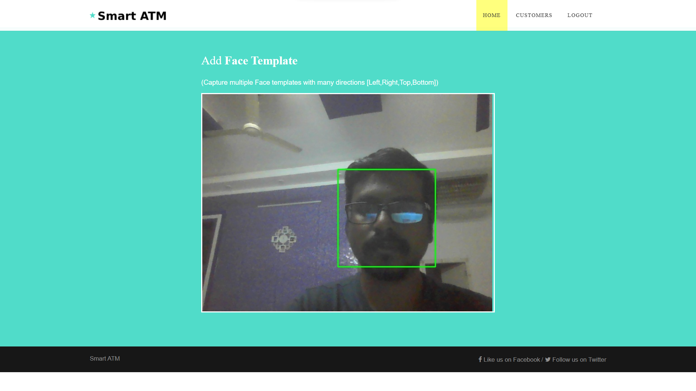
Screen Shots

Slide 32
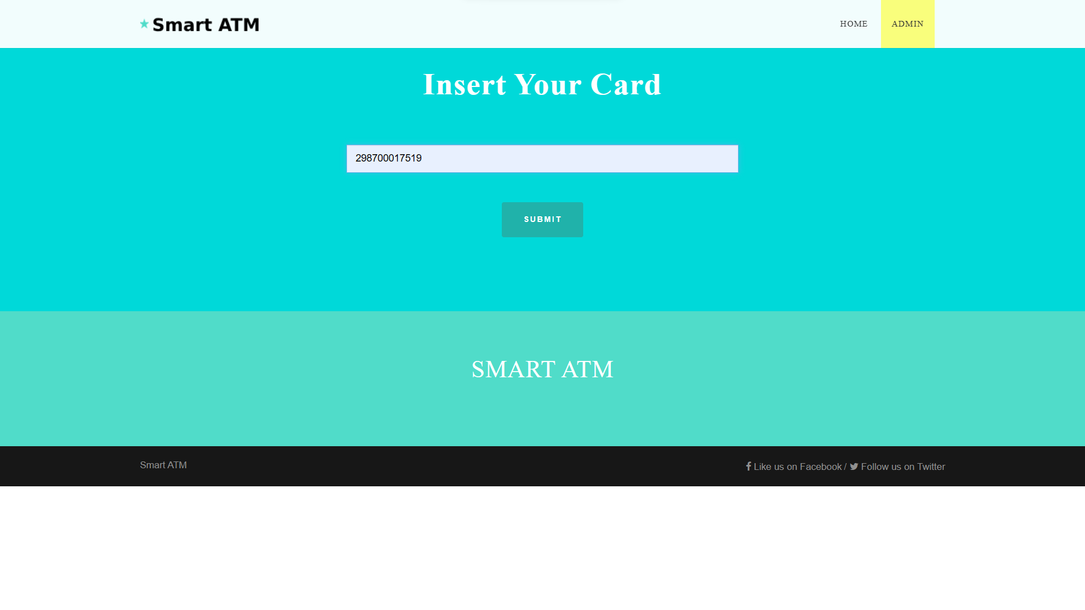
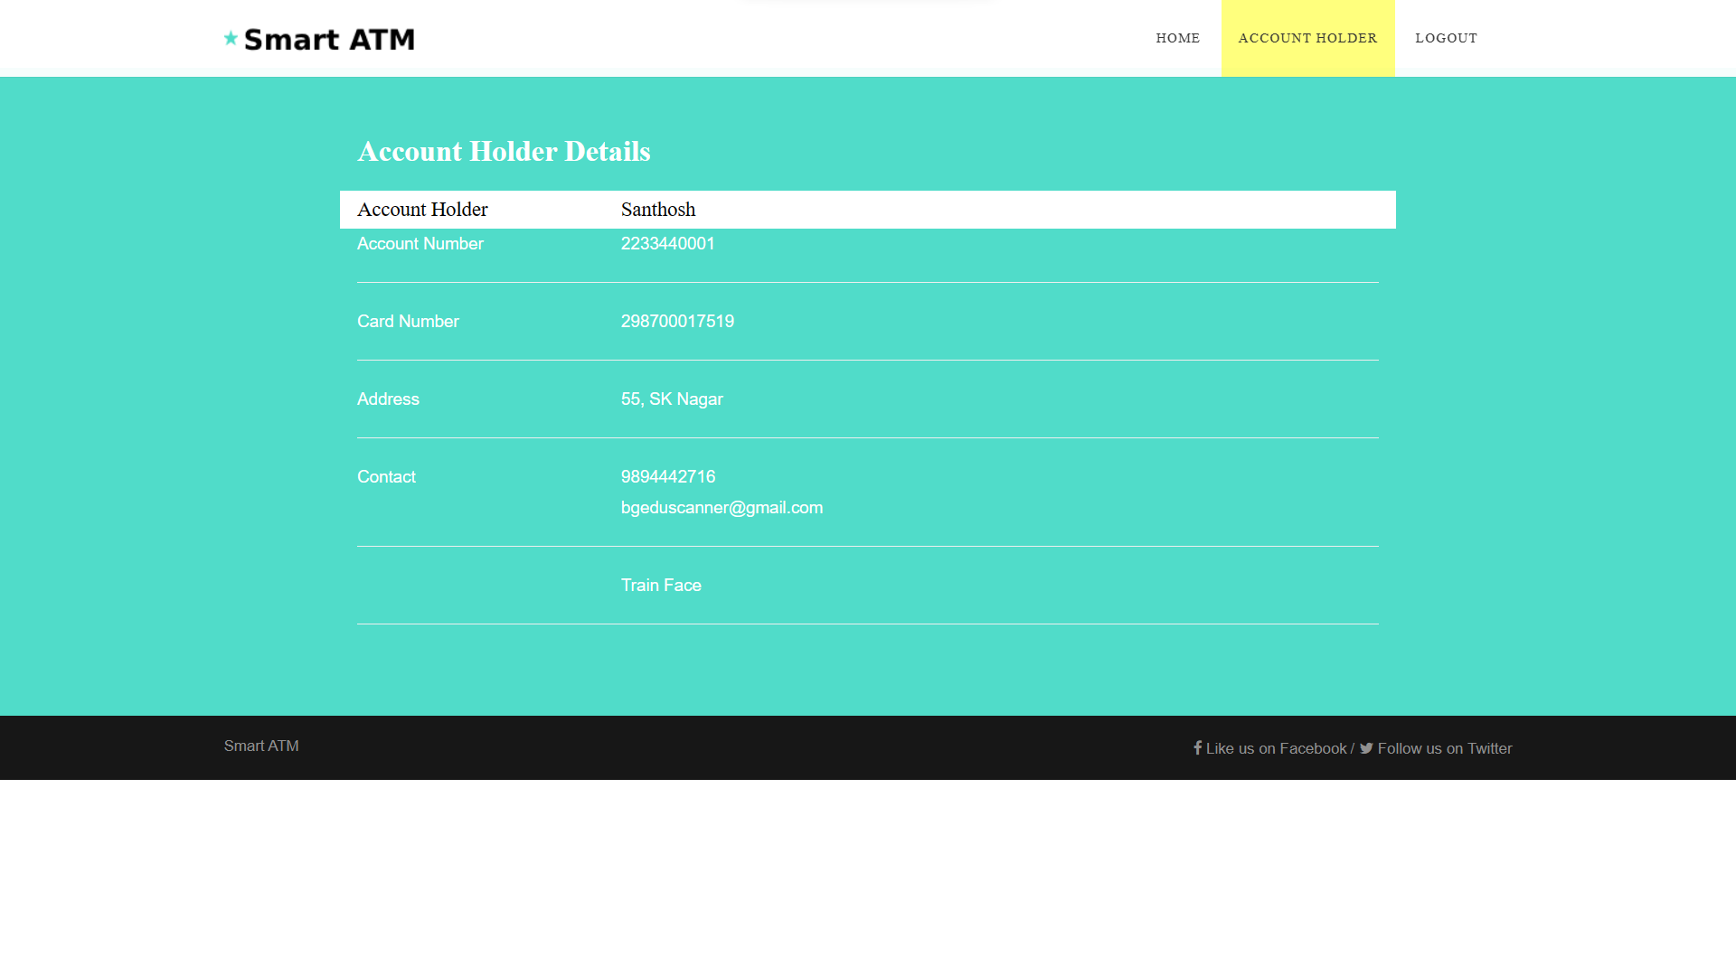
Screen Shots

Slide 33
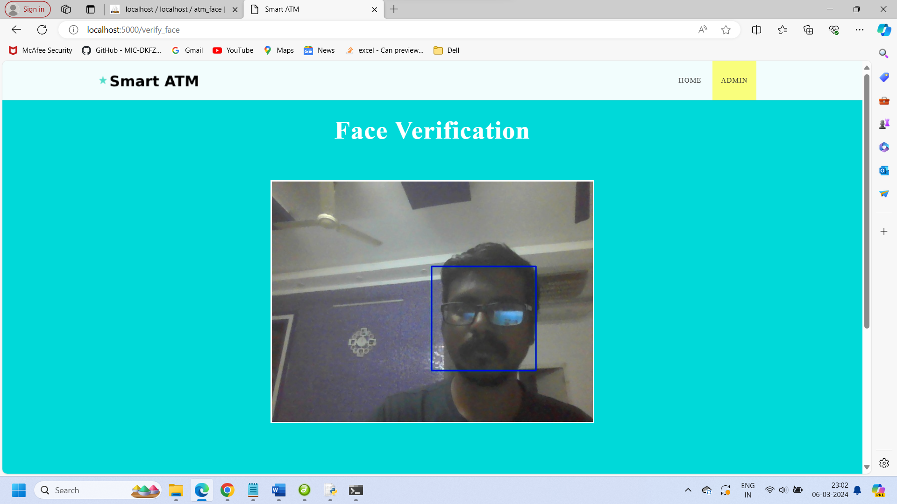
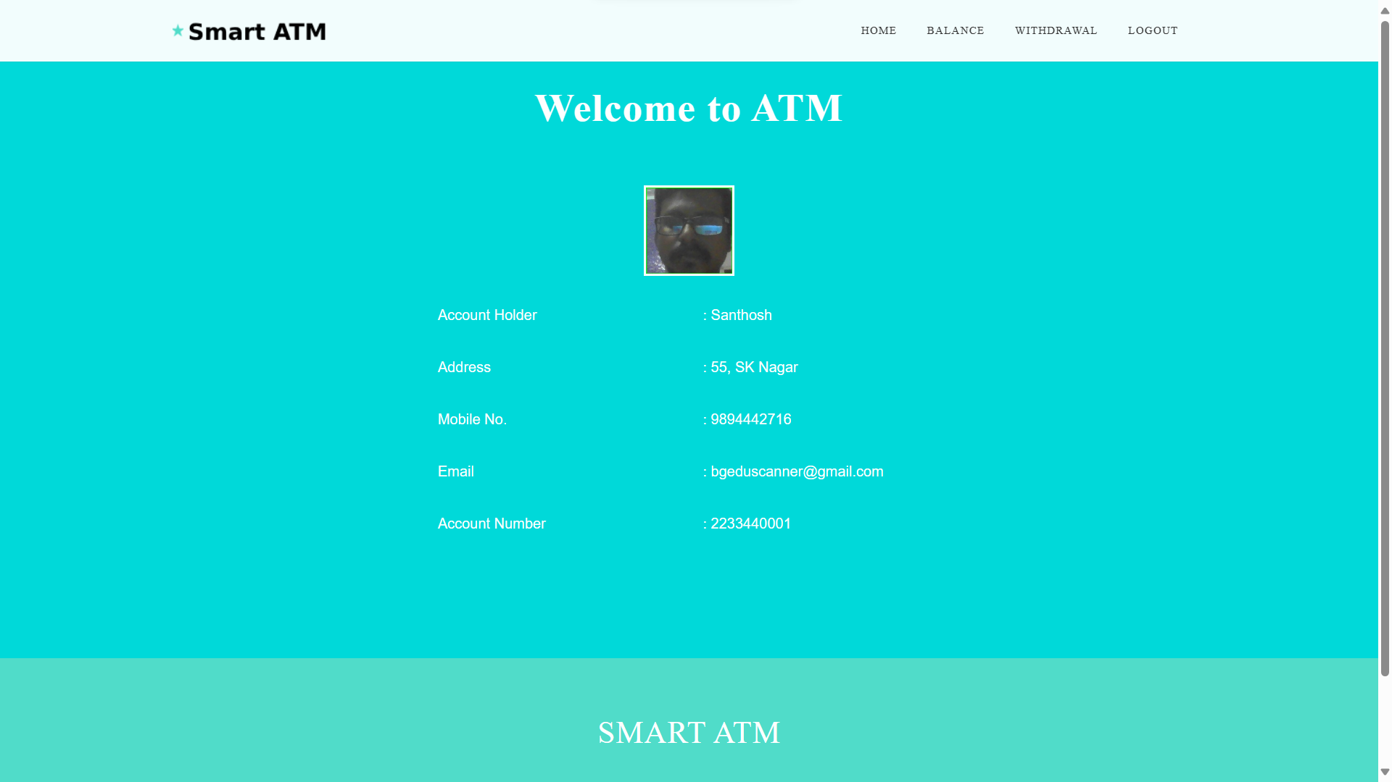
Screen Shots

Slide 34
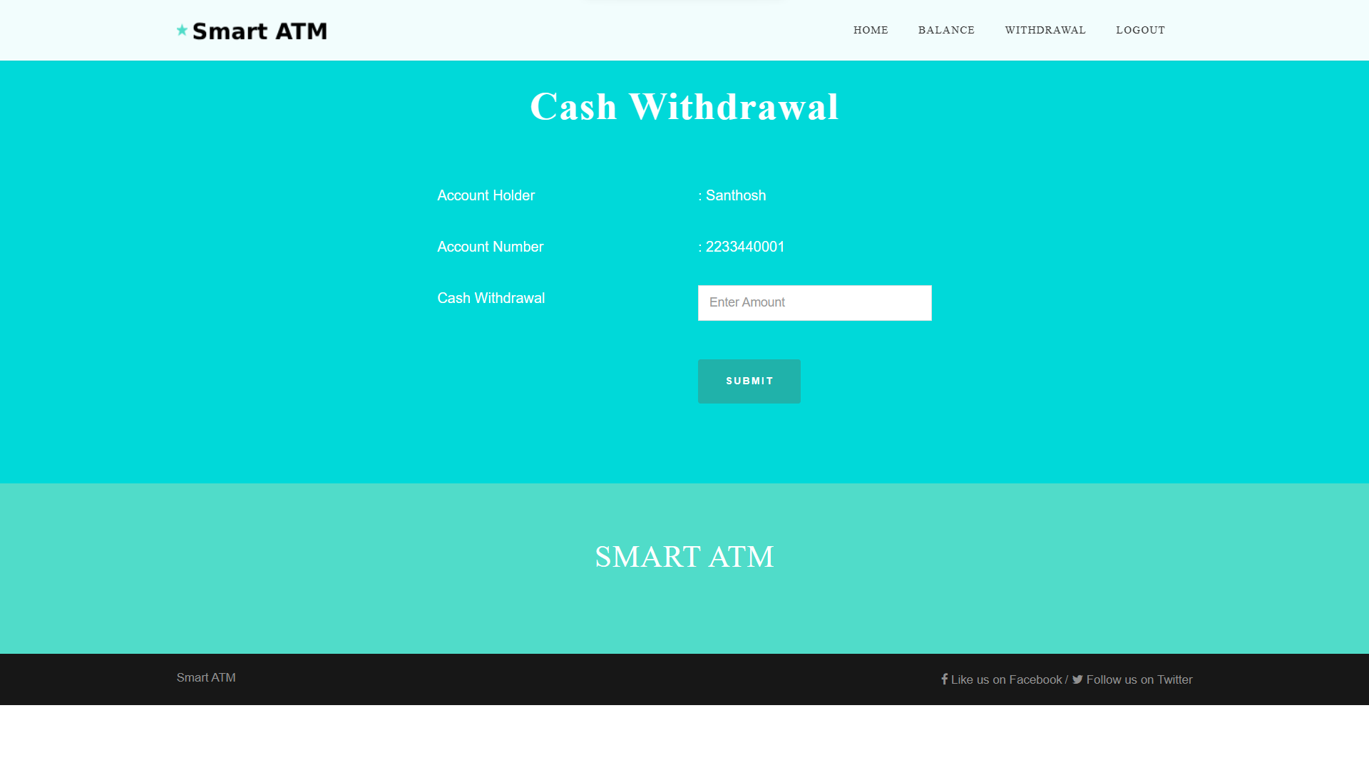
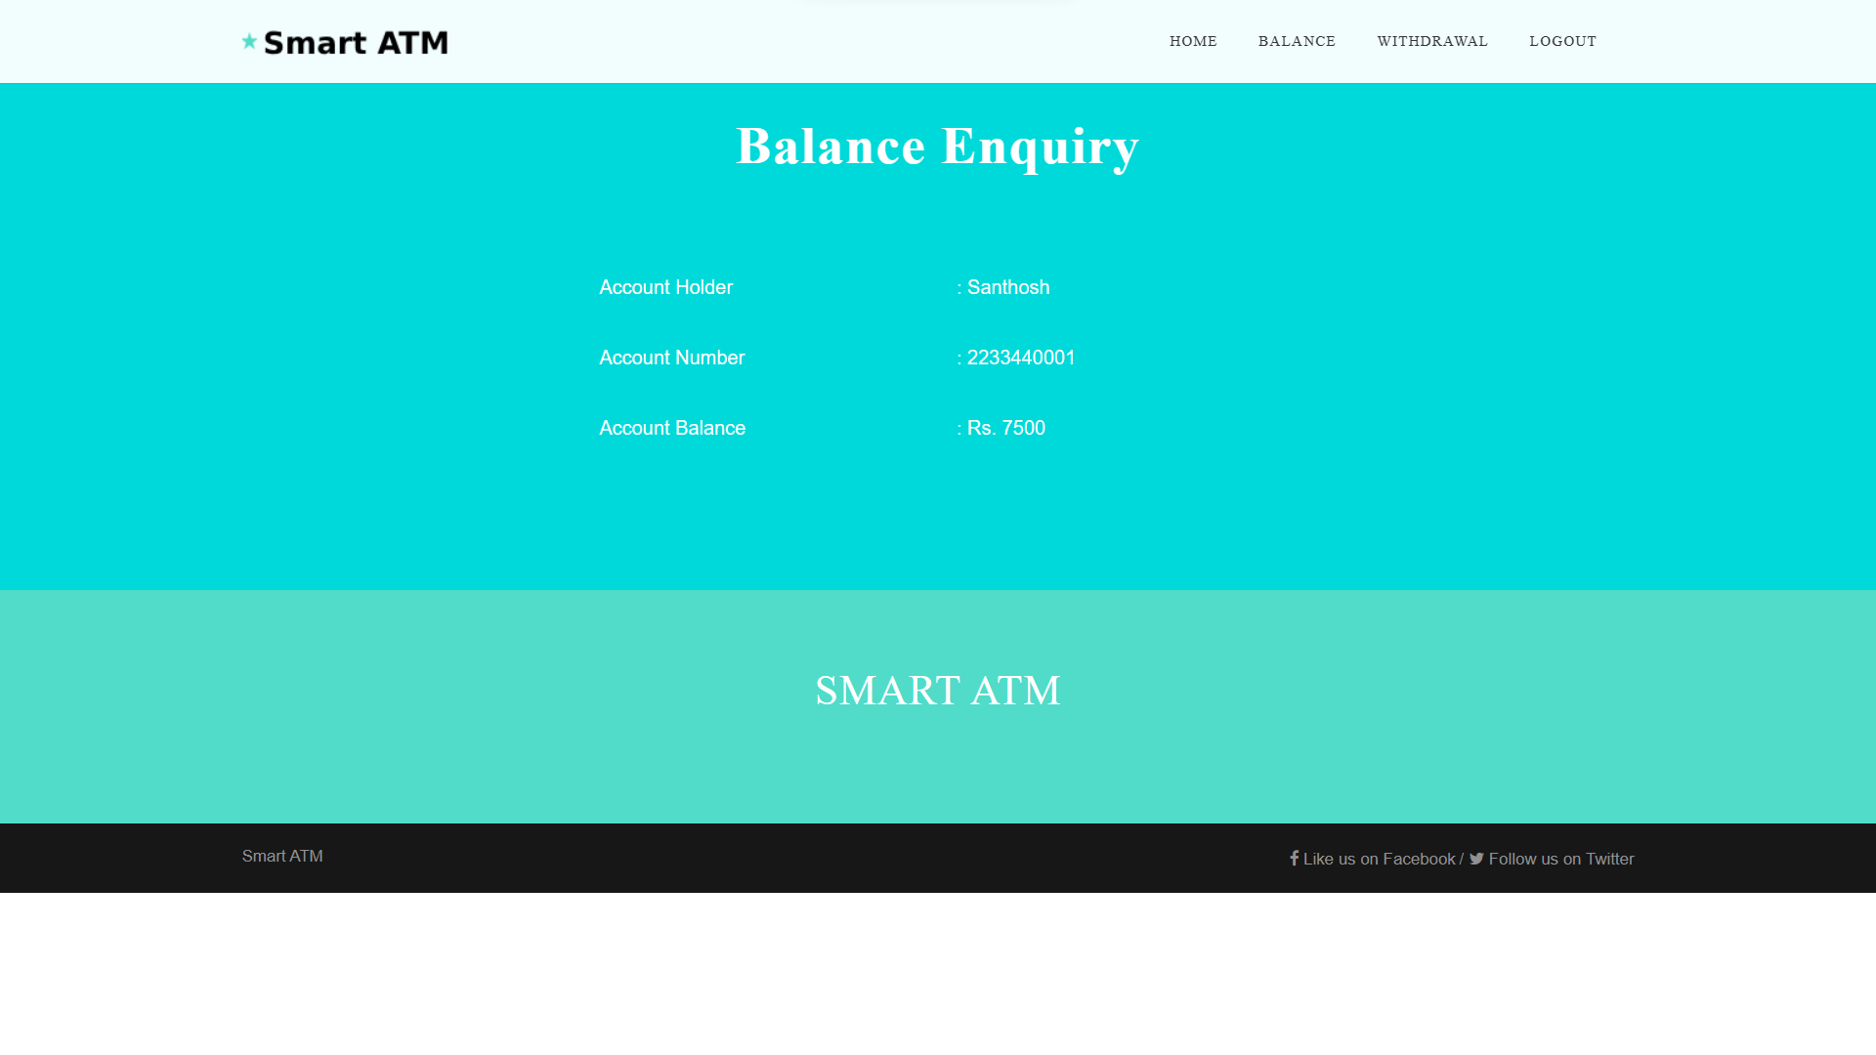
Screen Shots

Slide 35
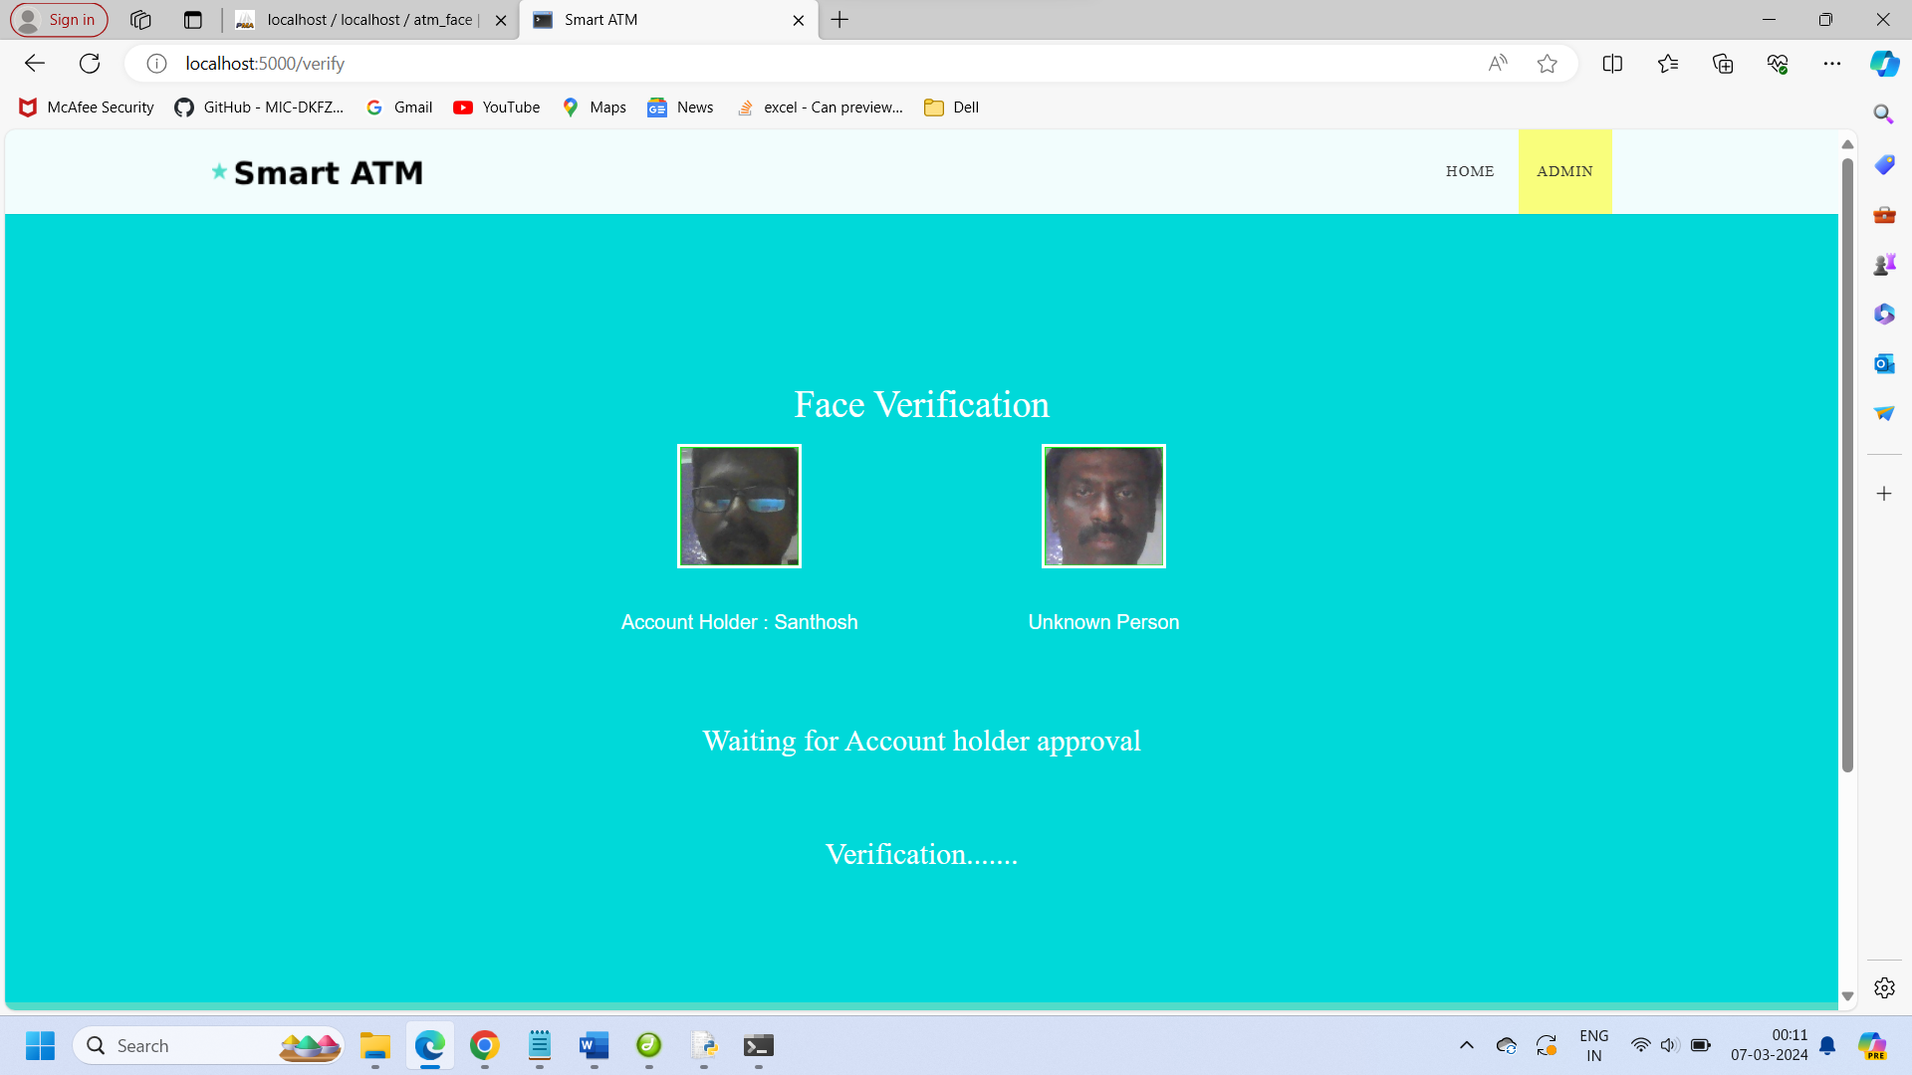
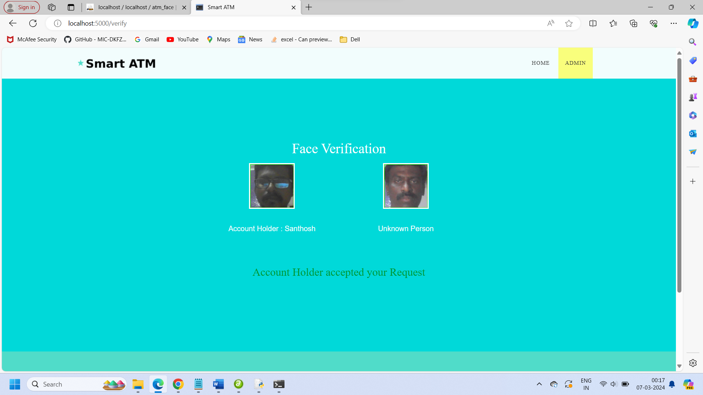
Screen Shots

Slide 36

Screen Shots

Slide 37
Conclusions
The ATM User Face Identification System enhances security by combining facial recognition technology with traditional PIN-based authentication. This integration adds an extra layer of protection while simplifying the user authentication process. Key achievements include implementing Convolutional Neural Networks (CNNs) for precise facial recognition, real-time transaction notifications, and a secure database for managing user data. Additional security measures like two-factor authentication and anomaly detection algorithms were also introduced to prevent fraud. After testing in a controlled environment, ongoing monitoring and improvements will ensure optimal performance. This system sets a new standard for secure and user-friendly ATM transactions.

Slide 38
FUTURE ENHANCEMENT
Support for multiple languages: The system could be expanded to support multiple languages, making it more accessible to users who are not fluent in the system's default language.
Support for additional transaction types: The system could be expanded to support additional types of transactions, such as account transfers or bill payments, to provide users with a more comprehensive banking experience
Integration with mobile banking: The system could be integrated with mobile banking applications to enable users to perform transactions and account management tasks using their mobile devices.

Slide 39
REFERENCES
[1] J. Liang, H. Zhao, X. Li, and H. Zhao, ``Face recognition system based on deep residual network,'' in Proc. 3rd Workshop Adv. Res. Technol. Ind. (WARTIA), Nov. 2017, p. 5.
[2] I. Taleb, M. E. Amine Ouis, and M. O. Mammar, ``Access control using automated face recognition: Based on the PCA & LDA algorithms,'' in Proc. 4th Int. Symp. ISKO-Maghreb, Concepts Tools Knowl. Manage. (ISKO-Maghreb), Nov. 2014, pp. 1-5.
[3] X. Pan, ``Research and implementation of access control system based on RFID and FNN-face recognition,'' in Proc. 2nd Int. Conf. Intell. Syst. Design Eng. Appl., Jan. 2012, pp. 716-719, doi: 10.1109/ISdea.2012.400.
[4] A. A. Wazwaz, A. O. Herbawi, M. J. Teeti, and S. Y. Hmeed, ``Raspberry Pi and computers-based face detection and recognition system,'' in Proc. 4th Int. Conf. Comput. Technol. Appl. (ICCTA), May 2018, pp. 171-174.

